Slide 1

Topical Section on
Life Cycle Sustainability Assessment (LCSA): update on activities
12:15 PM – 1.45PM
Jeroen Guinée & Gregory Norris

Slide 2
Agenda
Procedural/organisational issues
Working plan
Activities
  Topical groups
  SETAC-ISIE case study symposium
  Google⁺ platform, etc.
Q&A, suggestions, discussion

Slide 3
Procedural/organisational (P/O)
Section board
Primary governing body: Section Board
Board consists of 4 - 6 elected members, including Chair, Vice-Chair, Secretary, and Treasurer
All are elected by the membership for terms of two (2) years, and may be re-elected for additional terms
  Chair may serve for no more than 2 successive terms

Slide 4
P/O: Nominations and elections
To be held as soon as practically possible and after that biennially
Procedure of elections will be announced by preliminary Board at least 2 months prior to election date
Nominations either by Board or by self-nomination
  to be communicated to Chair at least 4 weeks prior to election date
Etc.
Notes:
….. to be determined further… checken met Melanie …
We need new elections and new candidates? Who??

Slide 5
Preliminary board until elections
Chair
Name | Affiliation
Jeroen Guinée | Leiden University, CML, Netherlands
Gregory Norris | Harvard School of Public Health USA
Michael Hauschild | DTU Management Engineering DK
Sarah McLaren | Massey University, New Zealand
Barbara Nebel | PE International, New Zealand
Robert Anex | University of Wisconsin Madison, USA
Matthias Finkbeiner | Technical University Berlin, Germany
Göran Finnveden | Royal Institute of Technology, Stockholm, Sweden
Pere Fullana Palmer | Escola Superior de Comerç Internacional, Barcelona
Sabrina Spatari | Drexel University, Philadelphia, USA
Steven Young | University of Waterloo, Canada
Bo Weidema | 2.-0 LCA consultants, Aalborg East, Denmark
Alissa Kendall | UC Davis, Civil and Environmental Engineering, USA
Josh Newell | University of Michigan, Ann Arbor, MI, USA
Vice-Chair
Board Members

Slide 6
P/O: Membership
Membership open to all ISIE members with an interest in life cycle sustainability assessment
Current LCSA membership is: 50+
Number of people lapsed:
  on purpose?
  just forgot to pay dues?
  …?

Slide 7
Working Plan (ISIE-LCSA_workingplan2012-2014_final_July2012.pdf)
WP builds on two principles:
  everybody is busy
  nobody wants additional travelling
Two objectives:
  provide functions
  create some real activities

Slide 8
Working plan - functions
Hallway virtual networking:
  who is doing what on LCSA?
  discussion groups
  sharing news
  networking
  drafting proposals, finding partners
  thematic pages
  LinkedIn group for the ISIE-LCSA membership
Public website
Tool: Google+ ?
Notes:
In addition to a Section internal platform for communication between section members, it would also be beneficial to the section to establish a public website showing what we are doing, keeping track of relevant events, publications, ongoing projects, ongoing student work etc. Such a site would support the dissemination of our work. We will explore the technical means, human and financial resources needed for creating and maintaining this website, emphasizing options which streamline site creation and upkeep.

Slide 9
Working plan – physical meetings
Today and tonight ☺
(Co-)organisation of workshops, conferences, …
Notes:
We think that as a start it would be very beneficial for all members to know who is who and what they are doing in the field of LCSA. This would enable us to learn about each other’s research activities and interests, which may help us form suitable and useful discussion groups around specific topics and may also be helpful for finding appropriate partners for research proposals and funding. In addition it may help students to find appropriate sources of information (or even secondary supervisors/advisors) for their research
Proposal: we (Jeroen and Greg) start a Google+ circle inviting all members of the ISIE-LCSA Section to join and briefly describe their current research activities and interests. Greg would do this but still no result unfortunately

Slide 10
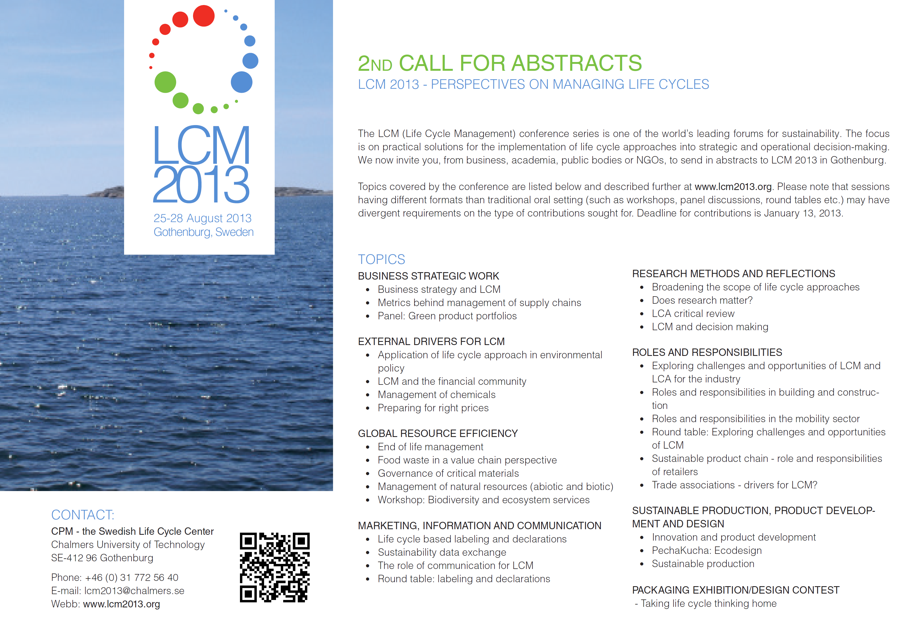

Slide 11





Notes:
Physical meetings, .. together with other organisations, e.g. LCM 2013 and SETAC Europe
Connected to the biannual meeting of ISIE we will organize physical section meetings. In exceptional cases, when other conferences may give reason for this (e.g., when many of the LCSA members visit a non-ISIE conference), we could organize other physical meetings.

Slide 12
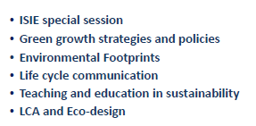
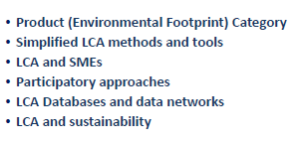
Abstract submission is open
Topics for the call for papers
ISIE Special Session
: Experiences with and criticisms of LCA as a tool for supporting policies and (bio-energy) performance-based regulation
Deadline abstract submission
5 September
http://lcarome.setac.eu

Slide 13
Working plan - activities
Working motive: “focused (not too broad) and feasible (not too ambitious)”
Who’s who and doing what?
Notes:
We think that as a start it would be very beneficial for all members to know who is who and what they are doing in the field of LCSA. This would enable us to learn about each other’s research activities and interests, which may help us form suitable and useful discussion groups around specific topics and may also be helpful for finding appropriate partners for research proposals and funding. In addition it may help students to find appropriate sources of information (or even secondary supervisors/advisors) for their research
Proposal: we (Jeroen and Greg) start a Google+ circle inviting all members of the ISIE-LCSA Section to join and briefly describe their current research activities and interests. Greg would do this but still no result unfortunately

Slide 14
(Working plan) - Topical groups
Anne Ventura (University of Nantes, FR) leads a topical activity group on “unresolved environmental LCA issues & sector methodological issue matrix”, focusing on the construction sector
  Work progresses although slowly of course

Slide 15
Google⁺ specs (Google+specs.docx)
Members-only area for
  virtual networking and meetings (max 5-15 people)
  file sharing and managing Section’s communication etc.
  topical pages/discussion sites, e.g., on what LCSA actually is ☺
  “who’s doing what” personal pages for members
  news and discussion fora
  ……
External website showing what we are doing, ….
Collaboration with SETAC LCSA group
  through special open page
Notes:
Members-only area for
virtual networking and meetings (max 5-15 people). Members can invite specific (groups of) other members or send out a general invitation for all members for a specific audio and/or video meeting, addressing a specific topic, while sharing documents and Powerpoint presentations.
file sharing and managing Section’s communication etc.
with simple topical pages (discussion sites). These can be established around key themes of the section that can be raised by any member of the section’s membership.
Who’s doing what personal pages for members. We think that it would be very beneficial for all members to know who is who and what they are doing in the field of LCSA. This would enable us to learn about each other’s research activities and interests, which may help us form suitable and useful discussion groups around specific topics and may also be helpful for finding appropriate partners for research proposals and funding. This who’s who could be set-up as “personal pages” under the internal website or in any other form.
news and discussion fora
……
External website. In addition to a Section internal platform for communication between section members, it would also be beneficial to the section to establish a public website showing what we are doing, keeping track of relevant events, publications, on-going projects, on-going student work etc. Such a site would support the dissemination of our work. We will explore the technical means, human and financial resources needed for creating and maintaining this website, emphasizing options which streamline site creation and upkeep.
To organize virtual LCSA section-broad meetings and discussions (including up to 50 people)

Slide 16


Important for now !!!!!!!!!!!
Main need now: setting up platform for virtual networking (Google+ or anything alike)
  Keep it simple
  Mail to: guinee@cml.leidenuniv.nl
Membership (spread the word ☺)
  During conference: please sign up at the ISIE Membership table
  After conference: mail to sign up for this section to Melanie Quigley: melanie.quigley@yale.edu

Slide 17
Q&A, suggestions, discussion ….
Question: biennial or annual ISIE conference?
….
Dinner

