Slide 1

Topical Section on
Life Cycle Sustainability Assessment (LCSA): update on activities
12:15 PM – 1.45PM
Jeroen Guinée & ???

Slide 2
Agenda
Membership
Election result: new section board
Past activities (2013-2015)
  Topical groups
  SETAC-ISIE case study symposium (November 2013, Rome); SETAC cooperation still open for further discussion
  Wiggio platform, etc.
New activities
  Reference to working plan
  Brainstorm (criterion: practical feasibility)
Q&A, suggestions, discussion

Slide 3
Membership
Membership open to all ISIE members with an interest in life cycle sustainability assessment
Current LCSA membership is: 50+
Number of people lapsed:
  on purpose?
  just forgot to pay dues?
  …?

Slide 4
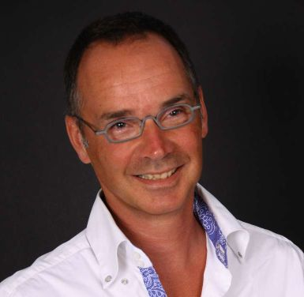
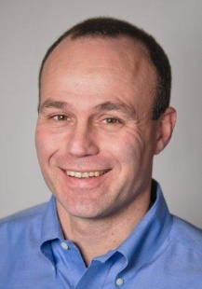
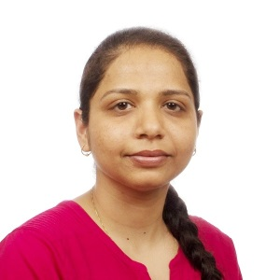
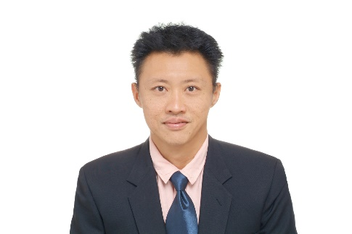
Election result: new section board
Chair: Jeroen Guinée
Vice-Chair: Tom Gloria
Secretary: Bhawna Singh
Treasurer: Harn-Wei Kua
All are elected for two (2) years
  may be re-elected for additional terms
  Chair may serve for no more than 2 successive terms
Elections from now on to be held biennially

Slide 5
Thanks to preliminary board!!
You are honourably discharged
Name | Affiliation
Jeroen Guinée | Leiden University, CML, Netherlands
Gregory Norris | Harvard School of Public Health USA
Michael Hauschild | DTU Management Engineering DK
Sarah McLaren | Massey University, New Zealand
Barbara Nebel | PE International, New Zealand
Robert Anex | University of Wisconsin Madison, USA
Matthias Finkbeiner | Technical University Berlin, Germany
Göran Finnveden | Royal Institute of Technology, Stockholm, Sweden
Pere Fullana Palmer | Escola Superior de Comerç Internacional, Barcelona
Sabrina Spatari | Drexel University, Philadelphia, USA
Steven Young | University of Waterloo, Canada
Bo Weidema | 2.-0 LCA consultants, Aalborg East, Denmark
Alissa Kendall | UC Davis, Civil and Environmental Engineering, USA
Josh Newell | University of Michigan, Ann Arbor, MI, USA

Slide 6
Past activities (2013-2015)
Topical groups:
  LCA & Construction group
  CLCA and ALCA
A session on “Experiences with and criticisms of LCA as a tool for supporting policies, certification, eco-labelling and (bio-energy) performance-based regulation” was organised at the SETAC case study symposium (November 2013, Rome)
  SETAC cooperation still open for further discussion
Wiggio platform, etc.

Slide 7
Past activities (2013-2015)
A session on “Experiences with and criticisms of LCA as a tool for supporting policies, certification, eco-labelling and (bio-energy) performance-based regulation” was organised at the SETAC case study symposium (November 2013, Rome)
  SETAC cooperation still open for further discussion

Slide 8
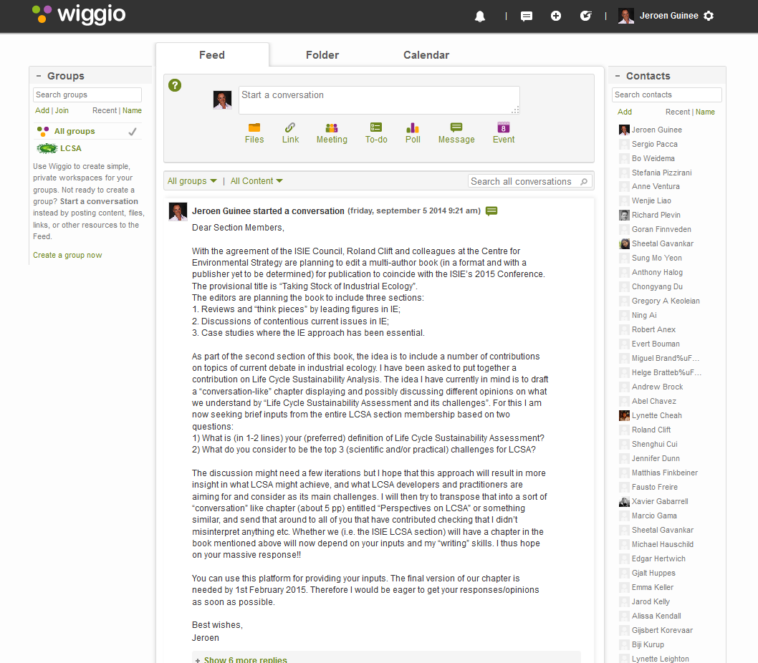
Past activities (2013-2015)

Slide 9
Past activities (2013-2015)
Wiggio platform established
  Thanks to Chongyang Du, Sheetal Gavankar and Stefania Pizzirani
  ISIE-LCSA members were invited to join the group in October 2013
  Some conversations were started up but soon ‘died’ out ☹
  Literature links were added in March 2014 by your chair, Stefania added one link and after that nobody added further links ☹
  What do we want with this platform?

Slide 10
Evaluation of past activities
What went well:
  Exposure of ISIE and ISIE-LCSA section through LCM Gothenborg conference and SETAC-Case Study Symposium Rome sessions
  Inauguration of topical groups
  Development and cooperation of Wiggio platform and some first exchanges/discussion

Slide 11
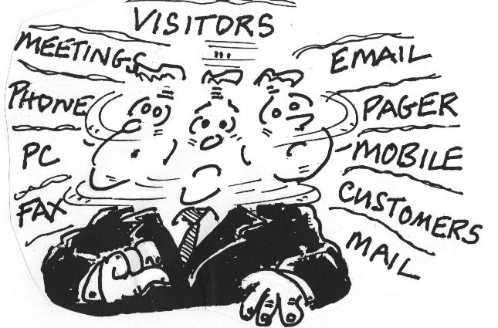
Evaluation of past activities
What didn’t go so well:
  Participation of ISIE(-LCSA) community in conference and symposium sessions mentioned
  Progress on papers of topical groups
  Active involvement on Wiggio platform
TIME …..
we’re all too busy

Slide 12
New activities; reference to Working Plan (ISIE-LCSA_workingplan2012-2014_final_July2012.pdf)
WP builds on two principles:
  everybody is busy
  nobody wants additional travelling
Two objectives:
  provide functions
  create some real activities

Slide 13
New activities; reference to Working Plan functions
Hallway virtual networking:
  who is doing what on LCSA?
  discussion groups
  sharing news
  networking
  drafting proposals, finding partners
  thematic pages
  LinkedIn group for the ISIE-LCSA membership
  Virtual platform: Wiggio
Public website
Physical meetings: today, ..
Notes:
In addition to a Section internal platform for communication between section members, it would also be beneficial to the section to establish a public website showing what we are doing, keeping track of relevant events, publications, ongoing projects, ongoing student work etc. Such a site would support the dissemination of our work. We will explore the technical means, human and financial resources needed for creating and maintaining this website, emphasizing options which streamline site creation and upkeep.

Slide 14
New activities; reference to Working Plan activities
Working motive: “focused (not too broad) and feasible (not too ambitious)”
Who’s who and doing what?
Notes:
We think that as a start it would be very beneficial for all members to know who is who and what they are doing in the field of LCSA. This would enable us to learn about each other’s research activities and interests, which may help us form suitable and useful discussion groups around specific topics and may also be helpful for finding appropriate partners for research proposals and funding. In addition it may help students to find appropriate sources of information (or even secondary supervisors/advisors) for their research
Proposal: we (Jeroen and Greg) start a Google+ circle inviting all members of the ISIE-LCSA Section to join and briefly describe their current research activities and interests. Greg would do this but still no result unfortunately

Slide 15
Previous List of Activities
LCSA framework;
Comparison of Consequential LCA and Attributional LCA: definitions, similarities and differences, how does it work;
Social issues in LC(S)A;
Sector-methodological issue matrix;
Sustainability as a positive good;
Unresolved environmental LCA issues;
Time frame;
LC(S)A and uncertainty;
LC(S)A and Multi Criteria Decision Analysis;
Bridging the gap between academic and industrial application;
Focus on issues related to industry sectors
Appropriate use of LCA in policy
Dealing with uncertainties
Emerging technologies
Biomass (including bioenergy), renewable energy (wind and solar), and construction
Notes:
We think that as a start it would be very beneficial for all members to know who is who and what they are doing in the field of LCSA. This would enable us to learn about each other’s research activities and interests, which may help us form suitable and useful discussion groups around specific topics and may also be helpful for finding appropriate partners for research proposals and funding. In addition it may help students to find appropriate sources of information (or even secondary supervisors/advisors) for their research
Proposal: we (Jeroen and Greg) start a Google+ circle inviting all members of the ISIE-LCSA Section to join and briefly describe their current research activities and interests. Greg would do this but still no result unfortunately

Slide 16
Prioritized List of Activities
LCSA framework;
Comparison of Consequential LCA and Attributional LCA: definitions, similarities and differences, how does it work;
Social issues in LC(S)A;
Sector-methodological issue matrix;
Sustainability as a positive good;
Unresolved environmental LCA issues;
Time frame;
LC(S)A and uncertainty;
LC(S)A and Multi Criteria Decision Analysis;
Bridging the gap between academic and industrial application;
Focus on issues related to industry sectors
Appropriate use of LCA in policy
Dealing with uncertainties
Emerging technologies
Biomass (including bioenergy), renewable energy (wind and solar), and construction
Notes:
We think that as a start it would be very beneficial for all members to know who is who and what they are doing in the field of LCSA. This would enable us to learn about each other’s research activities and interests, which may help us form suitable and useful discussion groups around specific topics and may also be helpful for finding appropriate partners for research proposals and funding. In addition it may help students to find appropriate sources of information (or even secondary supervisors/advisors) for their research
Proposal: we (Jeroen and Greg) start a Google+ circle inviting all members of the ISIE-LCSA Section to join and briefly describe their current research activities and interests. Greg would do this but still no result unfortunately

Slide 17
LCSA framework (5 min) - Jeroen
Outstanding issues, problems and challenges. Choose 5 to highlight.
As an opener, it is best left to Jeroen to address this :).
Harn can add a few words on current work but it has barely taken shape.
Notes:
We think that as a start it would be very beneficial for all members to know who is who and what they are doing in the field of LCSA. This would enable us to learn about each other’s research activities and interests, which may help us form suitable and useful discussion groups around specific topics and may also be helpful for finding appropriate partners for research proposals and funding. In addition it may help students to find appropriate sources of information (or even secondary supervisors/advisors) for their research
Proposal: we (Jeroen and Greg) start a Google+ circle inviting all members of the ISIE-LCSA Section to join and briefly describe their current research activities and interests. Greg would do this but still no result unfortunately

Slide 18
CLCA vs ALCA (5 min) - Harn
My own research area:
  Application of CLCA to key and emergent building materials, then apply to policy-making
  Consequences: changes to international trade and internal mobilization of material reserves
3 issues for discussion:
  System expansion in CLCA and ALCA.
  How do you decide and determine the consequences?
  Any challenges in defining economic and social consequences?
Notes:
We think that as a start it would be very beneficial for all members to know who is who and what they are doing in the field of LCSA. This would enable us to learn about each other’s research activities and interests, which may help us form suitable and useful discussion groups around specific topics and may also be helpful for finding appropriate partners for research proposals and funding. In addition it may help students to find appropriate sources of information (or even secondary supervisors/advisors) for their research
Proposal: we (Jeroen and Greg) start a Google+ circle inviting all members of the ISIE-LCSA Section to join and briefly describe their current research activities and interests. Greg would do this but still no result unfortunately

Slide 19
Social Issues in LC(S)A - Tom
What has been done
  UNEP SETAC seminal work in 2009
  Development of the SHD
  Roundtable on Product Social Impact Assessment
What are the issues
  Connection with
What can this group focus on
Notes:
We think that as a start it would be very beneficial for all members to know who is who and what they are doing in the field of LCSA. This would enable us to learn about each other’s research activities and interests, which may help us form suitable and useful discussion groups around specific topics and may also be helpful for finding appropriate partners for research proposals and funding. In addition it may help students to find appropriate sources of information (or even secondary supervisors/advisors) for their research
Proposal: we (Jeroen and Greg) start a Google+ circle inviting all members of the ISIE-LCSA Section to join and briefly describe their current research activities and interests. Greg would do this but still no result unfortunately

Slide 20
LC(S)A and uncertainty (5 min) – Harn & Bhawna
My own research area:
  Uncertainty analysis is to aid policymaking. How does one’s risk aversion causes one to react to a certain level of uncertainty?
  Use decision theory to use degree of risk aversion to “process" data uncertainty. Quite different from the more conventional approach of using normal or log-normal distribution estimation and Monte Carlo simulation.
Are there any other concepts to describe uncertainty?
How do policymakers or businesses react to data uncertainty?
Notes:
We think that as a start it would be very beneficial for all members to know who is who and what they are doing in the field of LCSA. This would enable us to learn about each other’s research activities and interests, which may help us form suitable and useful discussion groups around specific topics and may also be helpful for finding appropriate partners for research proposals and funding. In addition it may help students to find appropriate sources of information (or even secondary supervisors/advisors) for their research
Proposal: we (Jeroen and Greg) start a Google+ circle inviting all members of the ISIE-LCSA Section to join and briefly describe their current research activities and interests. Greg would do this but still no result unfortunately

Slide 21
Industry Applications of LCA - Tom
bridging the gap between academic and industrial application; focus on issues related to industry sectors; appropriate use of LCA in policy.
Areas of activity
  Data repositories – cost, breadth, depth, integration with LCIA
  EU Product Environmental Footprint
  Building and Construction - PCRs
    USGBC LEED Credits
  Sustainable Apparel Coalition
  Low Carbon Fuel Standards (EU, US, State of California)
  LCA Certified Professional
    The LCACP program is growing, with existing collaborations in several regions (e.g., Australia, New Zealand) and active discussions underway with other regions (e.g., Sweden).
Notes:
We think that as a start it would be very beneficial for all members to know who is who and what they are doing in the field of LCSA. This would enable us to learn about each other’s research activities and interests, which may help us form suitable and useful discussion groups around specific topics and may also be helpful for finding appropriate partners for research proposals and funding. In addition it may help students to find appropriate sources of information (or even secondary supervisors/advisors) for their research
Proposal: we (Jeroen and Greg) start a Google+ circle inviting all members of the ISIE-LCSA Section to join and briefly describe their current research activities and interests. Greg would do this but still no result unfortunately

Slide 22
Brainstorm: Q&A, suggestions, discussion ….
Past activities: which did and which didn’t work and why?
What do we want with the LCSA section?
New activities or revival of ‘old’ activities: tell us your ideas …….
….
Dinner

